Slide 1
Rain Man

Slide 2
Goals:
Our application will provide a convenient platform to input, save and edit custom paths
- The user will be able to view the water levels on each path and to chooses to start taking the path now, or in 10, 20 or 30 minutes.
- The user will be able to determine the fashion in which he travels, by car, by motorcycle, by bike or by foot.
- The app will calculate an average water level on each path, presenting the finds to the user. The app will also suggest which path among these paths should he take, when will he reach his destination, and when should he leave the house.
- The app will provide an interface to check the estimated amount of water that rained over
a given area, up to 30 days back.

Slide 3
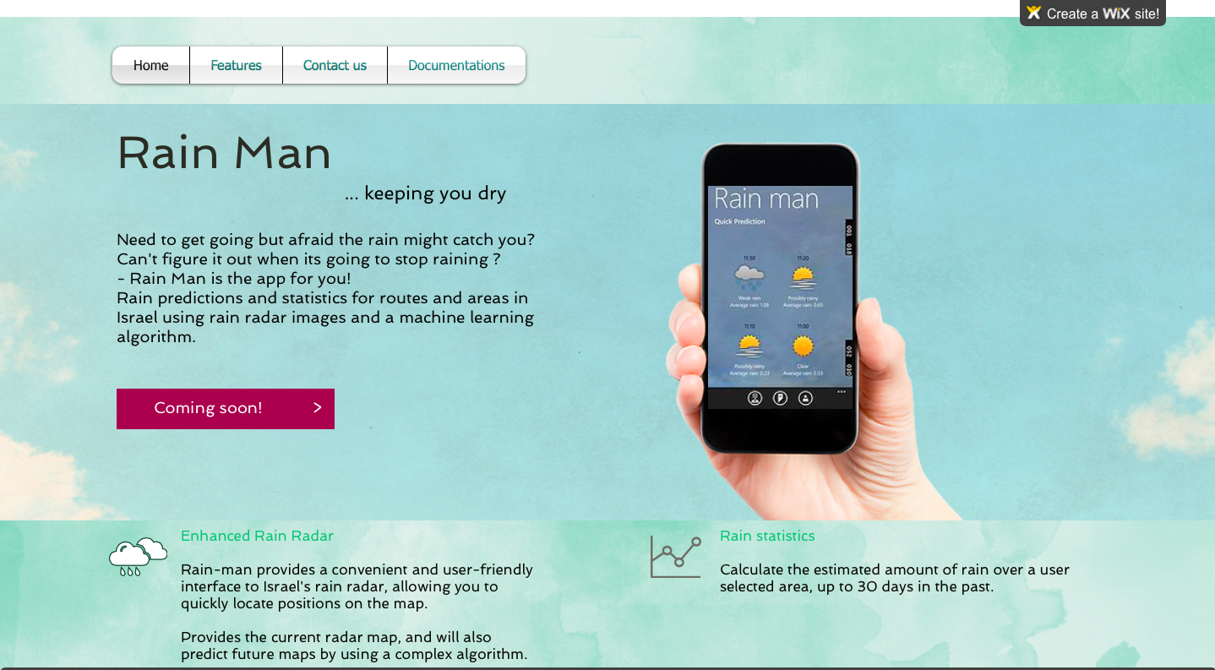
Our webise:
http://davidl24.wix.com/rainman

Slide 4
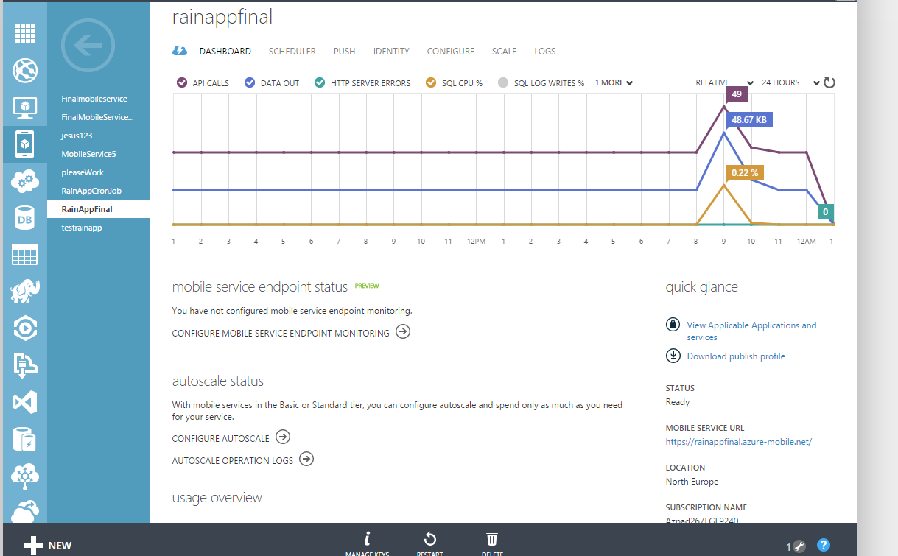
Technologies:
For the server side:
We use a mobile service to accommodate to following needs:
Maintain the tables for the application which include the paths, the user info ETC.
Provide API like an API for calculating the total amount of rain that poured over specific area over a period of time
Download pictures form the IMS and insert them to the Blob storage,
using Scheduled Jobs
4. Provide a convenient way of authorizing clients (facebook/Google)

Slide 5
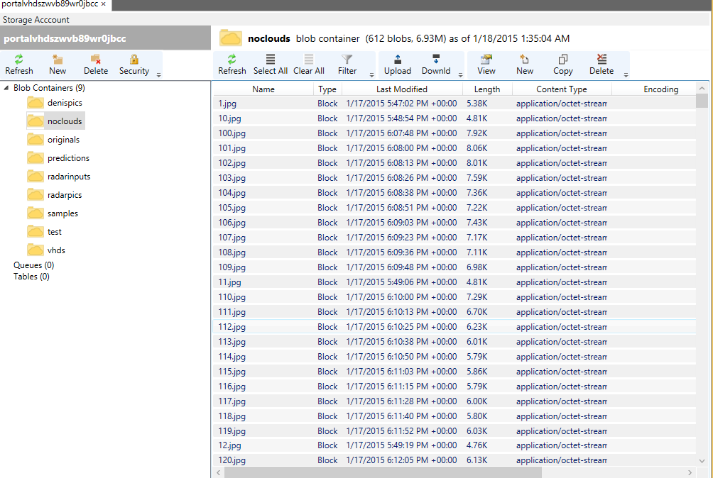
Blob Sorage:
This is our main storage for storing the images. We use it from the Linux vm and from the mobile service. It can handle images much better than the table storage or the SQL DB.

Slide 6
Live Demonstration

Slide 7
STOPPERS
No “Black Box” for computing the prediction images.
David has spent a month trying to install the program with no success.
Numeruos Emails to Ben did not succeed.
Prof. Wolf is trying to help us and one of his Master student is trying to install the prediction program on Azur.

